Slide 1
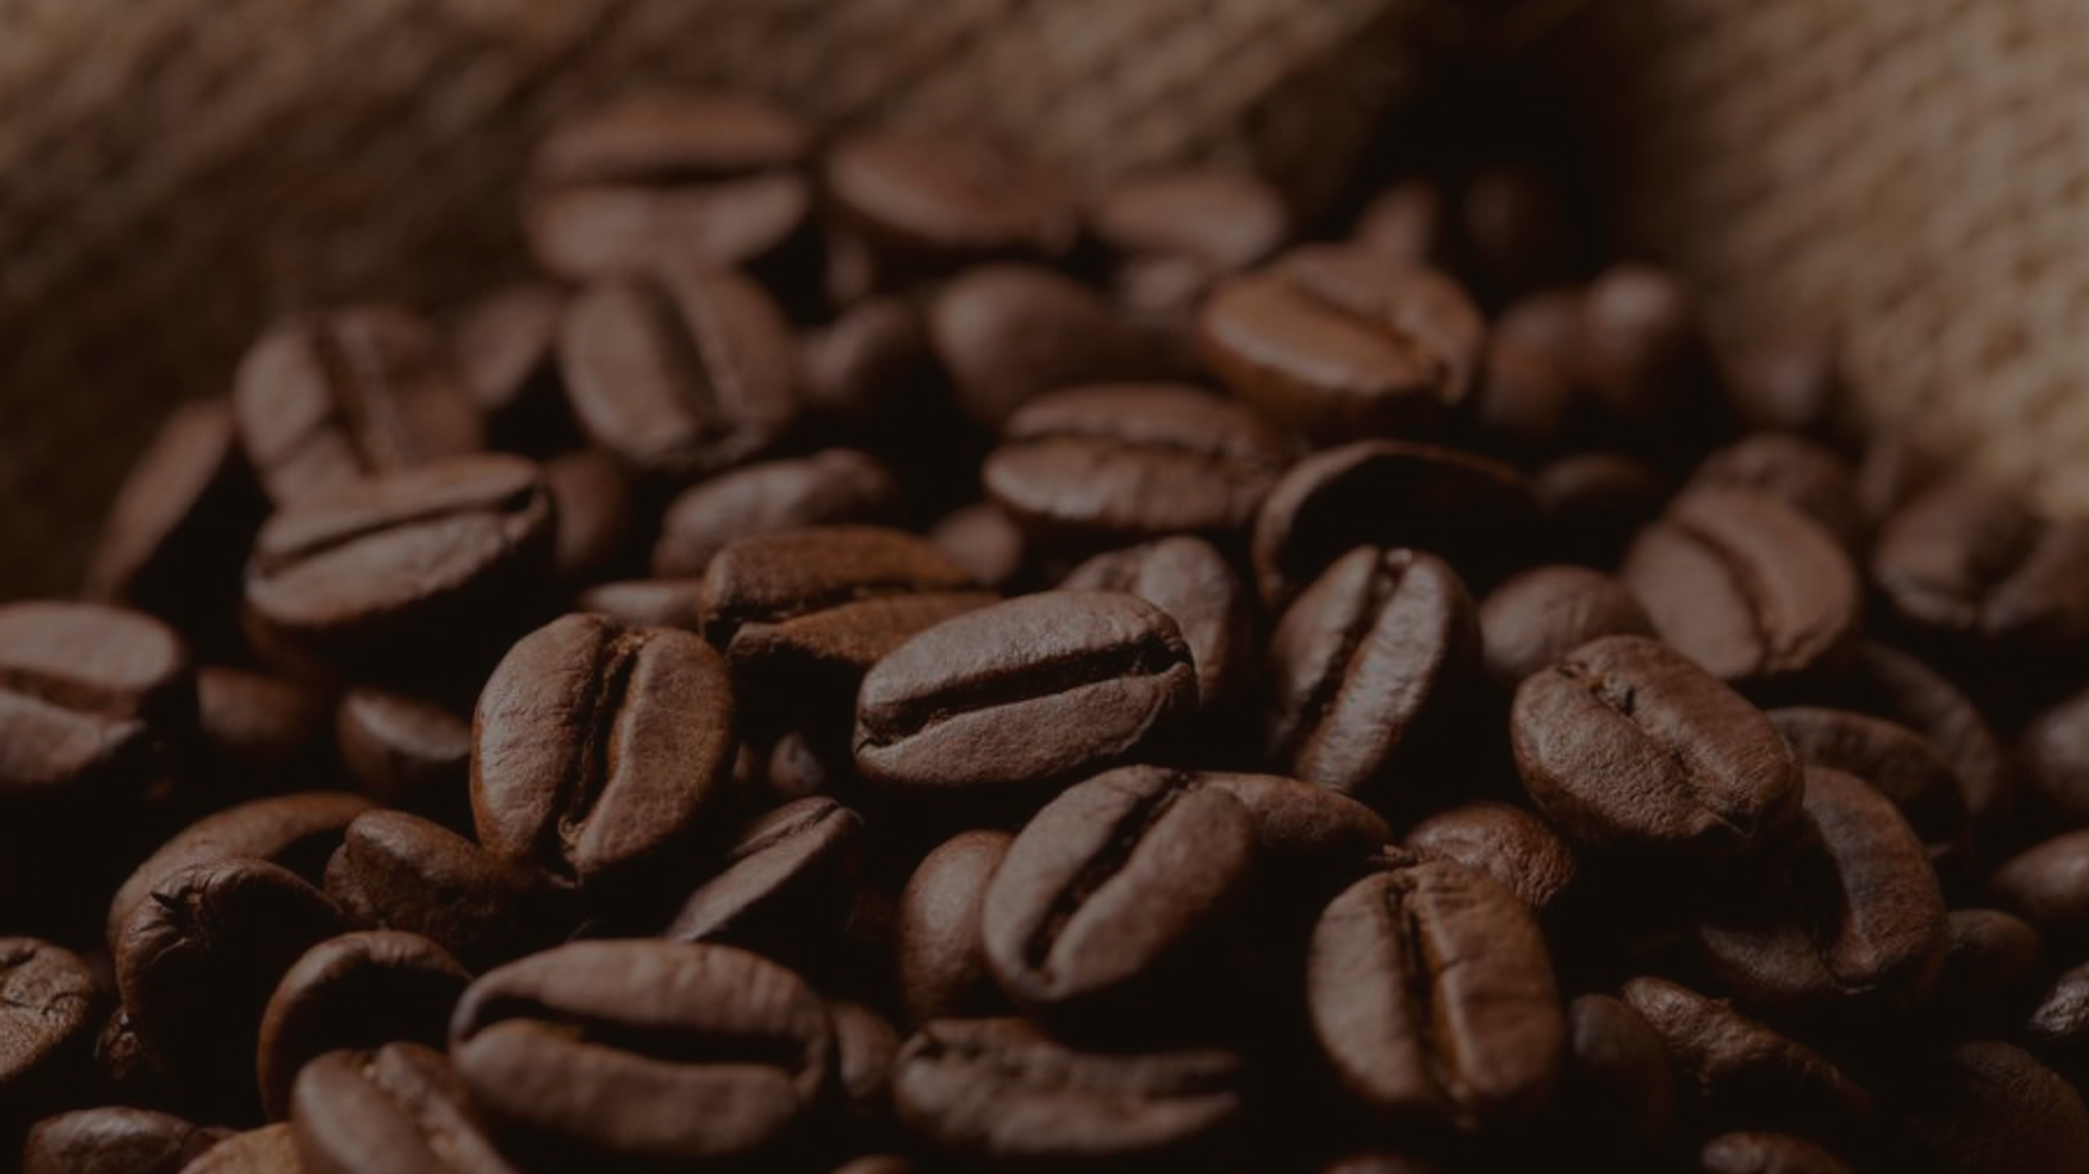

SALES ANALYSIS PRESENATATION

Slide 2

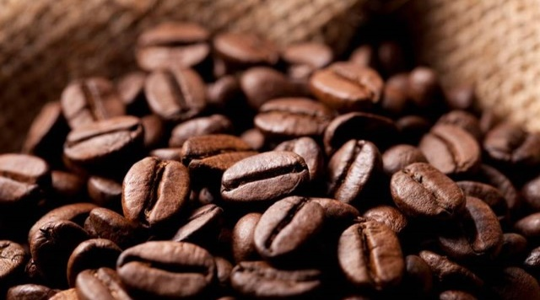
TABLE OF
CONTENTS
1.Introduction:Understanding the business
2. Analysis Breakdown:
Analysis by store
Analysis by product types and analysis by Days and Times
4.Key Insights & Recommendations
5.Future Growth

Slide 3
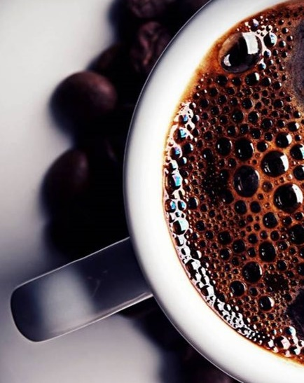
INTRODUCTION
Problem Statement
Product Performance
Aim
To provide a full picture of our performance in the last 6 months
Focus
Product Performance
Store Performance
Marketing Strategy Analysis

Slide 4
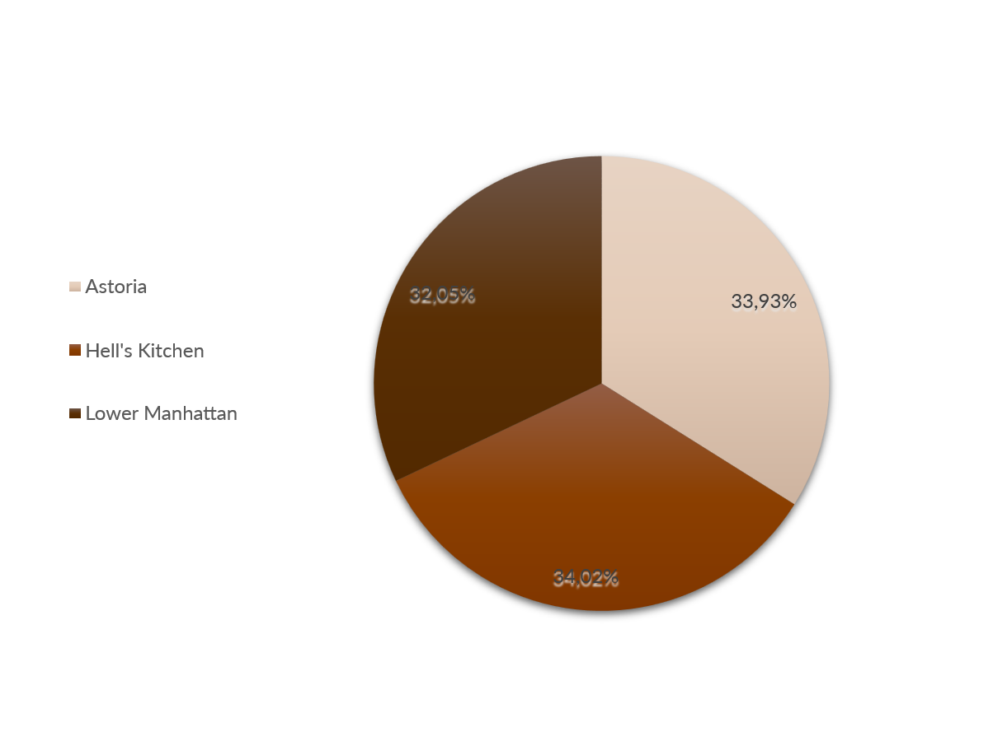
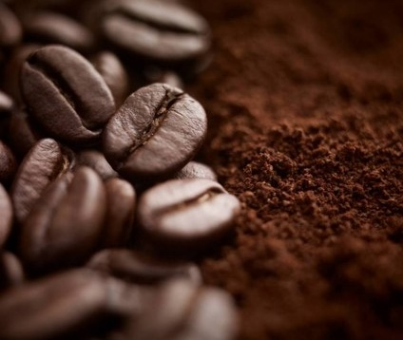
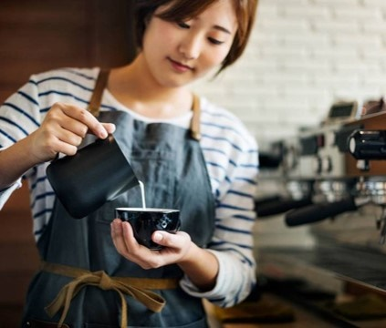
ABOUT US
Locations
Freshly-Baked Goods
Freshly-Baked Goods
Artisanal Tea & Drinking Chocolate
Lower Manhattan
Astoria
Hell's Kitchen
Lower Manhattan-32.05% of sales
It is located inside of a mall
Astoria -33.93% of sales
Astoria is a found by the corner of a street
Hell’s Kitchen -34% of sales
Hell’s kitchen is close to time square
Signature coffee beverages
Variety of coffee beverages
Three different size cups
Priced from $2.50 for a 12-ounce drip coffee to $5.75 for a 20-ounce latte
Provides a steady and reliable source of income
Highly predicable and high margin

Slide 5
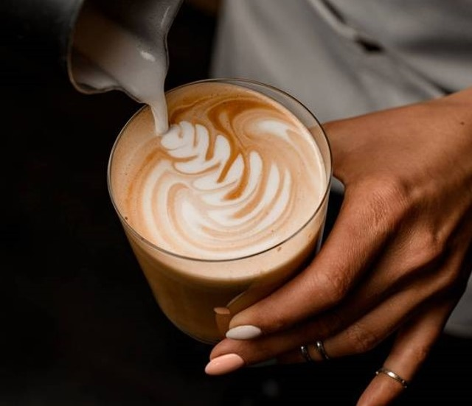

Analysis
By store locations , Months and time

Slide 6
Revenue By store location
Each store’s revenue has grown from January to June .Lower Manhattan consistently leads in revenue, followed closely by Hell’s Kitchen and Astoria. Overall, all three stores contribute almost equally to total revenue, showing balanced performance across locations

Slide 7
Revenue Analysis by time of day
We are a morning-rush business. The "golden hours" between 8 AM and 10 AM drive over 50% of our total daily revenue.
This pattern is universal across all three store locations; the morning is the main sales driver for Hell's Kitchen, Astoria, and Lower Manhattan.
Revenue drops sharply after 11 AM, leaving the afternoon and evening as a significant, untapped opportunity.
The clear takeaway: We are excelling at the "morning routine" but have a major opportunity to create a new afternoon/evening customer base.
Suggestions:
Capitalize on the morning rush: Offer premium breakfast combos or express takeaway options to maximize peak-hour sales.
Optimize operating hours: If evening sales remain low, consider closing earlier or reducing staff during low-demand hours.

Slide 8
Analysis
By product types and times

Slide 9
What Are We Selling? (Analysis by Product)
Coffee is #1, but Tea is our strong #2 category.
Chai & Chocolate are the best sellers .Our top-selling types are "Brewed Chai tea" and "Hot chocolate."
The Key Customer Habit: The core customer habit isn't "coffee + food." It's "buying a high-quality specialty drink," which could be Coffee, Tea, or Hot Chocolate.
Suggestions:
Promote Our Real Winners
Create a "Chai Lover's" or "Tea Time" special to capitalize on the proven popularity of our #2 category.
Use Drinks to Sell Food (Not the Other Way)
-Since "Bakery" is our #3 category, it's an opportunity for growth.
-Create a "Perfect Pairing" combo (e.g., "Add a Pastry to any Chai or Hot Chocolate for $2").

Slide 10
ANALYSIS: The "Golden Hours"
The Afternoon is a "Dead-Zone": After the morning peak, revenue stays flat and low for the rest of the day. This pattern is consistent across all store locations.
The "Time Buckets" graph shows that the Morning drives the vast majority of our sales.
Suggestions:
Ensure peak staffing from 7 AM to 11 AM to serve customers as fast as possible
Possibly apply an "Afternoon Recharge" special (e.g., "Half-price Chai Lattes" or "Tea Time Combo") from 2 PM to 4 PM.

Slide 11
Our Path Forward: Insights & Strategy
Key Insights: What We Learned
50%
75%
#1
1. Our top sellers are Chai Tea & Hot Chocolate.
2. We are a "Morning Rush" Business: Our "Golden Hours" are 8 AM - 11 AM, driving over 50% of all revenue.
3. We are a "Weekday Routine" Business: 75% of our sales happen from Monday to Friday.

Slide 12
Future Growth
Launch a Digital Loyalty App to retain our core weekday customers.
In order to try and retain our core weekday customers.
Expand our high-margin
Tea & Chocolate Menu with new seasonal flavors.

Slide 13
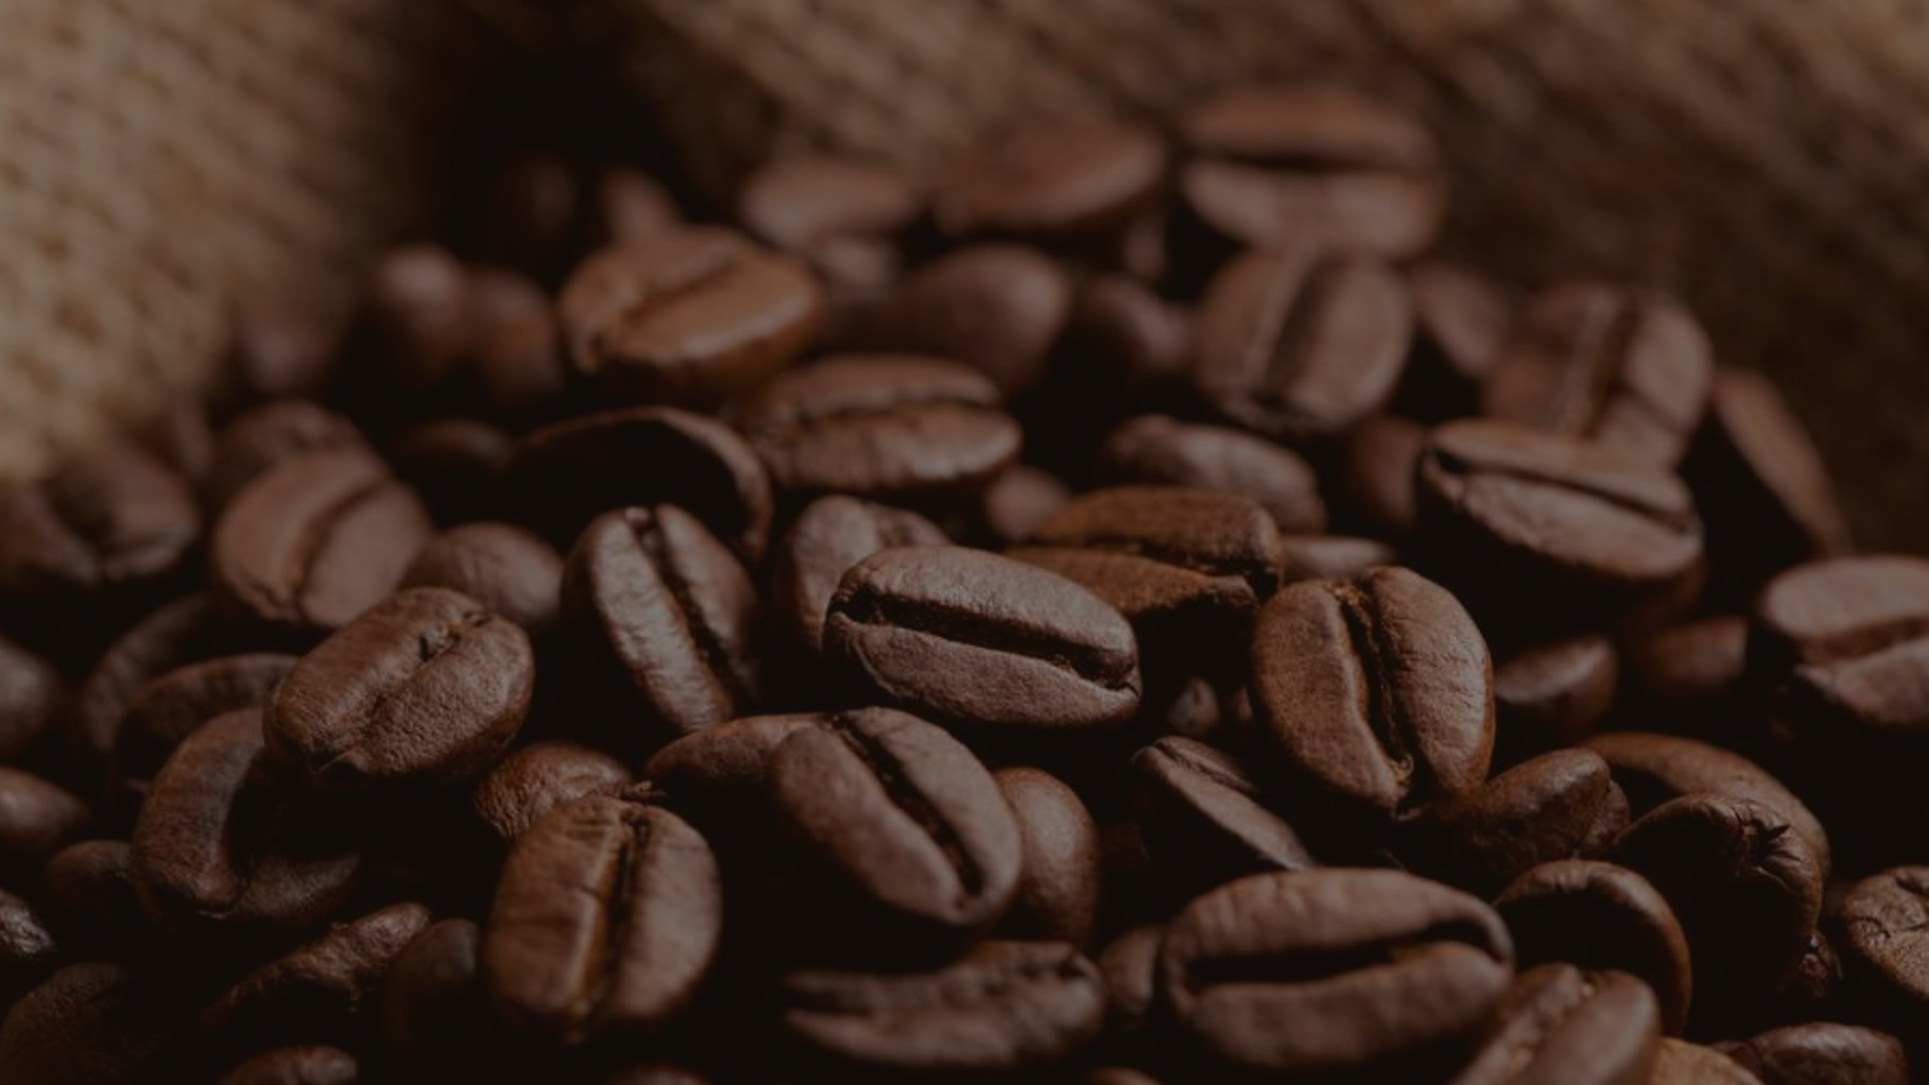

Thank you
Contact us at
Sonu Jain
sonu@fourthcoffee.com
405-555-0145

